Slide 1
Graph Generative Models lecture-3 Course on Graph Neural Networks for Knowledge-Graph Systems (Winter Term 22/23)
Prof. Dr. Holger Giese (holger.giese@hpi.uni-potsdam.de)
Christian Medeiros Adriano (christian.adriano@hpi.de) - “Chris”
Matthias Barkowsky (matthias.barkowsky@hpi.de)
Iqra Zafar (iqra.zafar@hpi.de)

Slide 2
Lecture topics
Threats to Validity
Inductive & Transductive Tests
Sensitivity Analysis
Null Models
Random Graph model
Small-World model
Kronecker model
Deep Generative model

Slide 3
Motivation
We need null-models to compare our graph metrics in a principle and reproducible manner
Obtain a real network
Generate a synthetic network
Compare networks
Null-models are generate by synthetic graph generation procedures.
Random Graph Model
Small-World Model
Kronecker Graph Model

Slide 4
Threats to validity
Construct validity: measurements might not be correct
Conclusion validity: instruments or methods adopted are not adequate
Internal validity: relations of cause-effect might not be true
External validity: results do not generalize to slight changes in the data or context.
Recommended readings:
Siegmund, J., Siegmund, N., & Apel, S. (2015, May). Views on internal and external validity in empirical software engineering. In Proceedings of the 37th International Conference on Software Engineering-Volume 1 (pp. 9-19). IEEE Press.
Wieringa, R. J. (2014). Design science methodology for information systems and software engineering. Springer.
Wohlin, C., Runeson, P., Höst, M., Ohlsson, M. C., Regnell, B., & Wesslén, A. (2012). Experimentation in software engineering. Springer Science & Business Media.

Slide 5
Transductive and Inductive Tests
Transduction or transductive inference is reasoning from observed, specific (training) cases to specific (test) cases.
Induction is reasoning from observed training cases to general rules, which are then applied to the test cases. [Wikipedia 2022]
Transductive Tests involve predicting nodes that were already seen during training
Uses: testing label propagation, label spreading, Partitioning transduction, Agglomerative transduction
Inductive Tests involve nodes never seen during training.
Uses: subgraph pattern identification, edge and node prediction
[Wikipedia 2022] https://en.wikipedia.org/wiki/Transduction_(machine_learning)

Slide 6
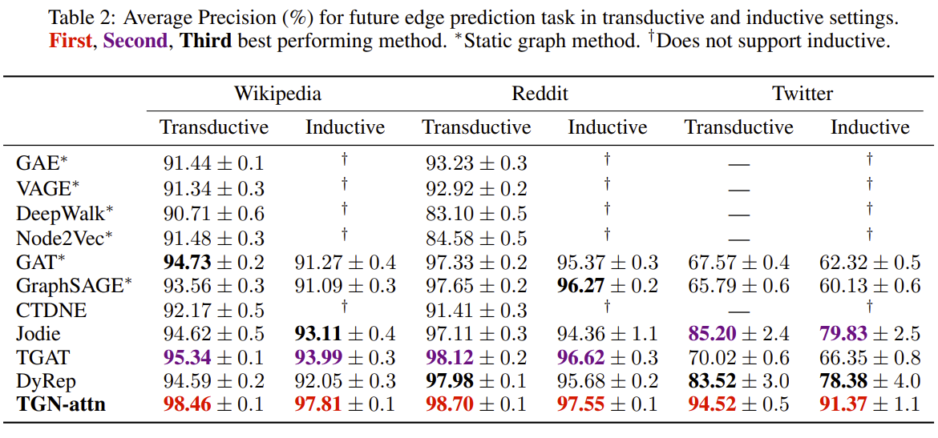
Transductive and Inductive Tests - Example
Rossi, Emanuele, et al. "Temporal graph networks for deep learning on dynamic graphs." arXiv preprint arXiv:2006.10637 (2020).

Slide 7
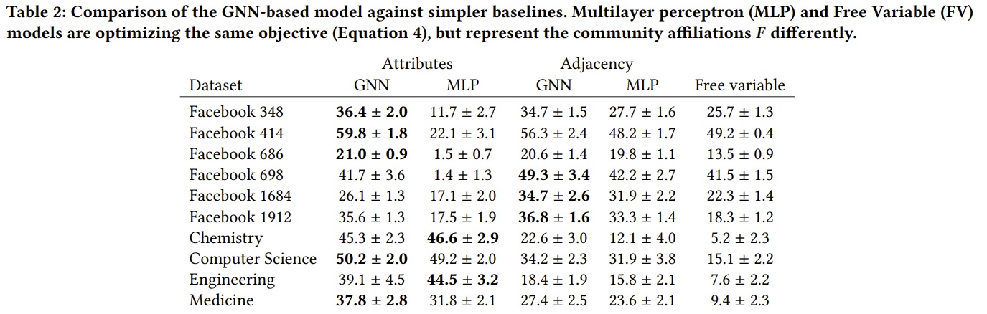
Ablation study - Community Detection
Shchur, Oleksandr, and Stephan Günnemann. "Overlapping community detection with graph neural networks." arXiv preprint arXiv:1909.12201 (2019).

Slide 8
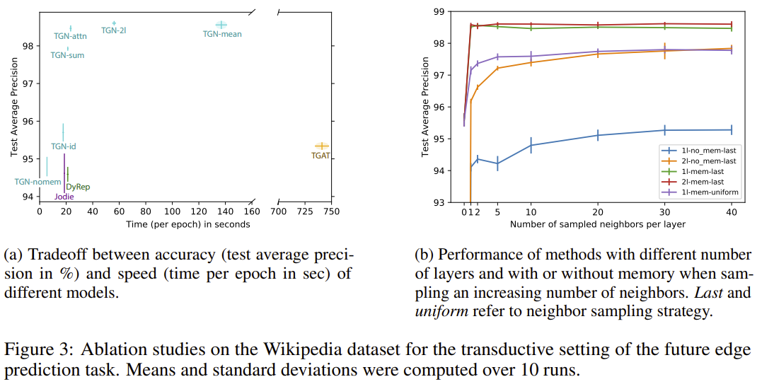
Ablation studies -Temporal Graph Network
Rossi, Emanuele, et al. "Temporal graph networks for deep learning on dynamic graphs." arXiv:2006.10637 (2020).

Slide 9
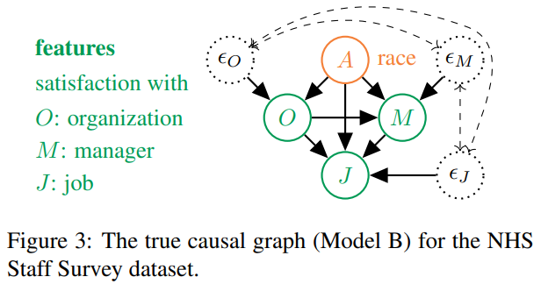
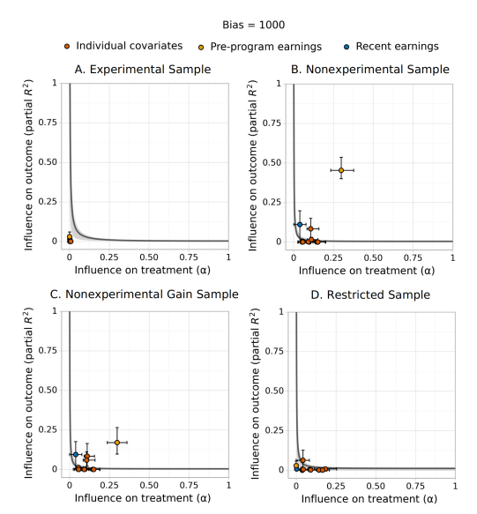
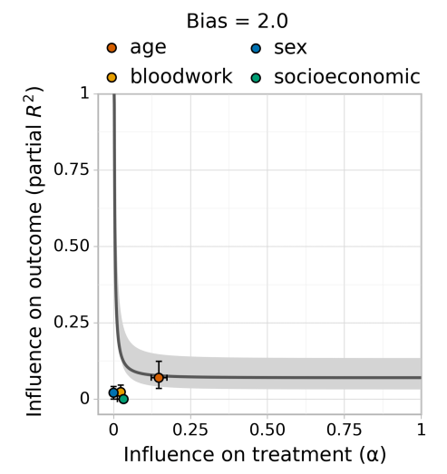
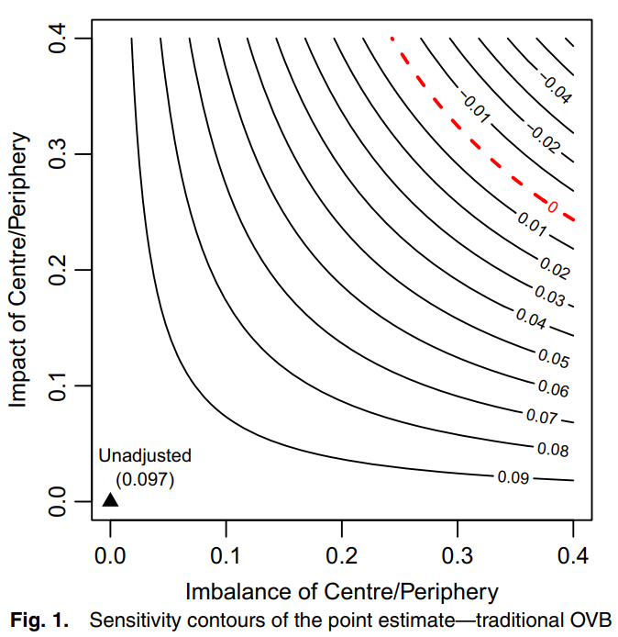
Sensitivity analysis – Latent Factors
Selection bias
Data imbalance
Independent variables correlated with explanatory variable
[Veitch et al 2020, Cinelli et al. 2019, Kilbertus et al. 2019]
Notes:
Wang, Xin, Ziwei Zhang, and Wenwu Zhu. "Automated Graph Machine Learning: Approaches, Libraries and Directions." arXiv preprint arXiv:2201.01288 (2022).
APA

Slide 10
Sensitivity analysis - Hyperparameters
Hyperparameter sensitivity*
batch size
learning rate
size of fully-connected layer
size of graph convolution layer
*Hyper-Parameter Optimization HPO: Wang, Xin, Ziwei Zhang, and Wenwu Zhu. "Automated Graph Machine Learning: Approaches, Libraries and Directions." arXiv:2201.01288 (2022).
Notes:
Wang, Xin, Ziwei Zhang, and Wenwu Zhu. "Automated Graph Machine Learning: Approaches, Libraries and Directions." arXiv preprint arXiv:2201.01288 (2022).
APA

Slide 11
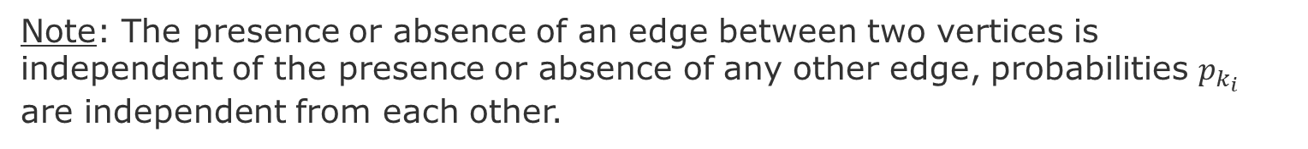
Random Graph - Erdös-Rényi (ER) networks
Stochastically connect nodes
E
E
E
A
A
A
F
F
F
B
H
B
H
B
H
C
G
C
G
C
D
D
G
D
Procedure:
For each pair of nodes decide do connect them with a probability $p_{k}$
Note: The presence or absence of an edge between two vertices is independent of the presence or absence of any other edge, probabilities $p_{k_{i}}$ are independent from each other.
Source: Newman, Mark EJ, Steven H. Strogatz, and Duncan J. Watts. "Random graphs with arbitrary degree distributions and their applications." Physical review E 64.2 (2001): 026118.

Slide 12
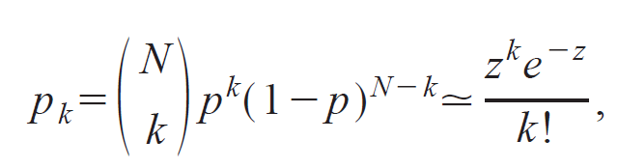
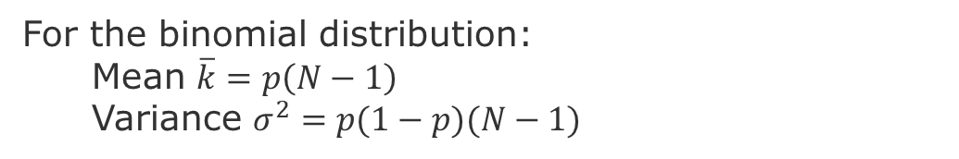
Random Graph – Distribution of Node Degree
Distribution of Node Degrees
z = average number of edges
k = degree of an edge
In the limit when N is very large. i.e., a Poisson distribution
For the binomial distribution:
Mean $\overline{k}=p\left(N−1\right)$
Variance $σ^{2}=p(1−p)(N−1)$
Newman, Mark EJ, Steven H. Strogatz, and Duncan J. Watts. "Random graphs with arbitrary degree distributions and their applications." Physical review E 64.2 (2001): 026118.
Notes:
Poisson Distribution = probability of a given number of events occurring in a fixed interval of time or space if these events occur with a known constant mean rate and independently of the time since the last event

Slide 13
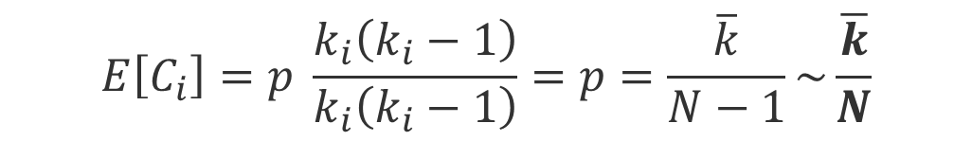

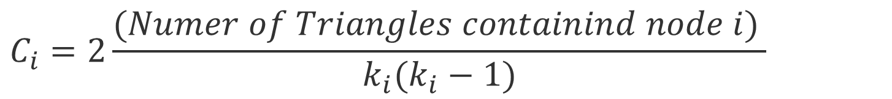
Random Graph – Clustering coefficient
Clustering coefficient:
$$C_{i}=2\frac{{(Numer of Triangles containind node i)}_{ }}{k_{i}(k_{i}−1)}$$
$$E\left[e\right]=p \frac{k_{i}(k_{i}−1)}{2}$$
Expected local clustering coefficient = p
$$E\left[C_{i}\right]=p \frac{k_{i}\left(k_{i}−1\right)}{k_{i}\left(k_{i}−1\right)}=p=\frac{\overline{k}}{N−1}\sim \frac{\overline{k}}{N}$$
This means that the clustering coefficient of a random graph is small.
Because as we generate bigger random graphs with a fixed average degree k, i.e., we set 𝑝=𝑘⋅1/N), C will decrease with the graph size N
Notes:
To derive this formula see

Slide 14
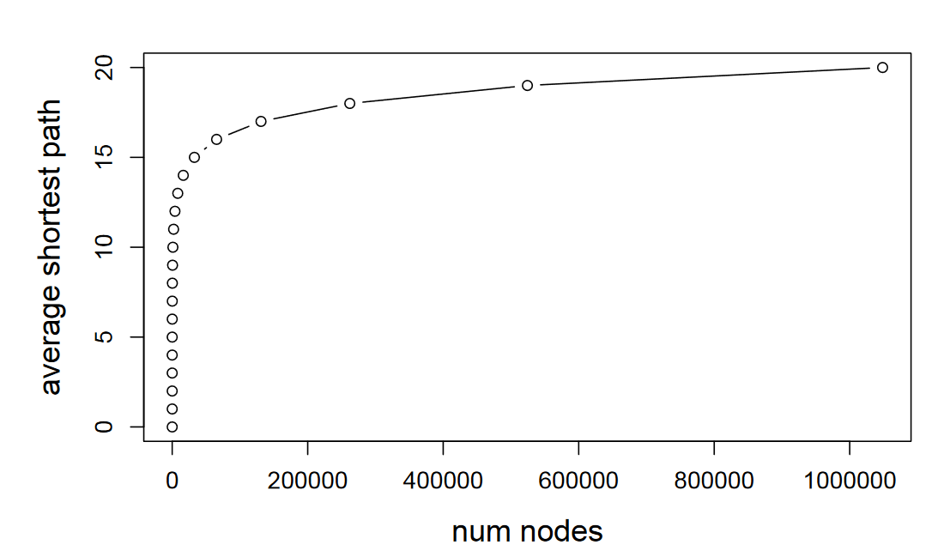
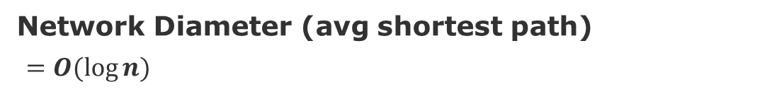
Random Graph – Network Diameter
Network Diameter (avg shortest path)
$=O(log⁡n)$
[Leskovec 2019]
Average degree constant
Notes:
[Leskovec 2019] http://web.stanford.edu/class/cs224w/slides/02-gnp-smallworld.pdf

Slide 15
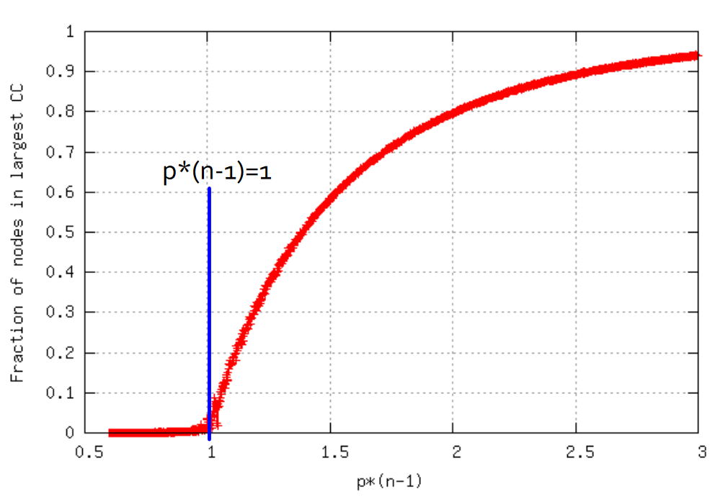
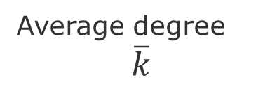
Random Graph – Connectivity
Tend to have giant components
Everything gets connected.
Disconnected graph
Fully connected graph
Average degree
$$\overline{k}$$

Slide 16
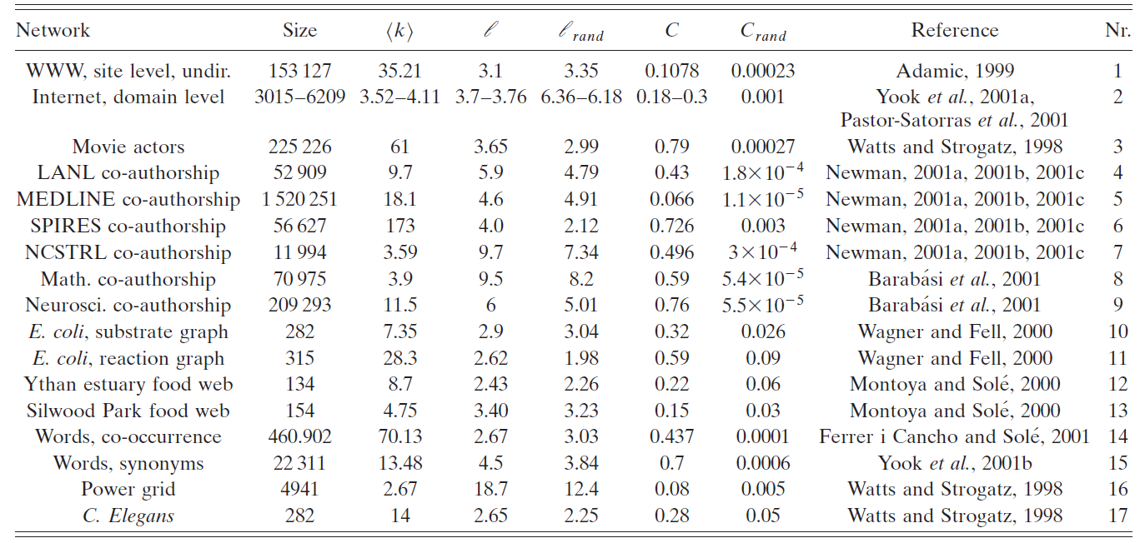
Again - Comparing some networks
Average Clustering coefficient
Average degree
Network diameter
Actors
Power grid
C. elegans
Source:
Albert, R., & Barabási, A. L. (2002). Statistical mechanics of complex networks. Reviews of modern physics, 74(1), 47.

Slide 17
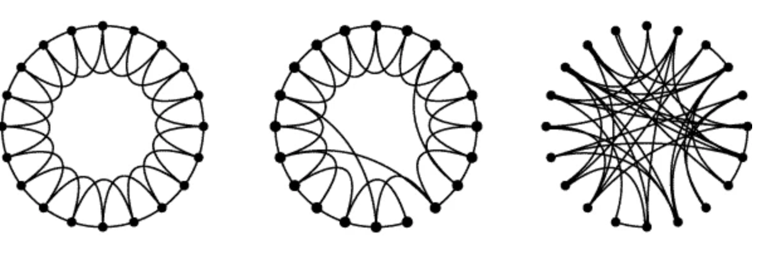
Small-World Model = high clustering + short paths
Regular
Small-World
Random
Note:
Clustering implies edge “locality”
Randomness enables “shortcuts
p =0
p=1
p = probability of reconnecting uniformly
Clustering
Diameter
High
High
High
Low
Low
Low
Procedure:
start with a ring of n vertices, each connected to its k-nearest neighbors by undirected edges.
choose a node and the edge that connects it to its nearest neighbor in a clockwise.
reconnect with probability p this edge to a node chosen uniformly over the entire ring
Source: Watts, Duncan J., and Steven H. Strogatz. "Collective dynamics of ‘small-world’networks." nature 393.6684 (1998): 440-442.
Notes:
Procedure: start with a ring of n vertices, each connected to its k nearest neighbors by undirected edges.
We choose a node and the edge that connects it to its nearest neighbor in a clockwise sense. With probability p, we reconnect this edge to a vertex chosen uniformly at random over the entire ring.

Slide 18
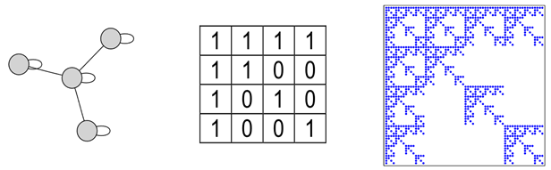
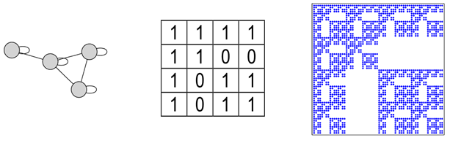
Kronecker Model
Small-World model captures the structure of many realistic networks
However, it does not produce the correct degree distribution
Solution: use the idea do self-similarity (the whole is in the parts)
Code to generate: https://github.com/BenjaminDHorne/Stochastic-Kronecker-Generator
Source: Leskovec, Jure, et al. "Kronecker graphs: an approach to modeling networks." Journal of Machine Learning Research 11.2 (2010).

Slide 19
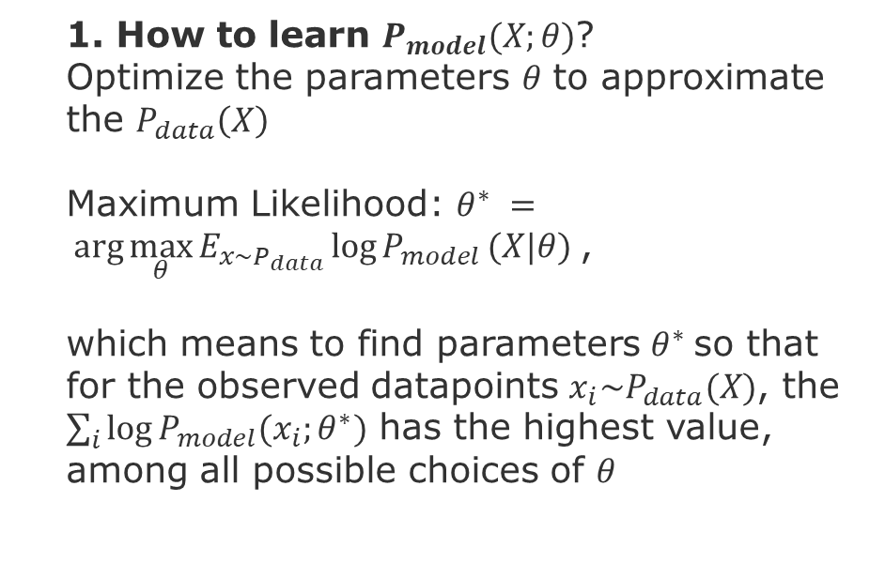
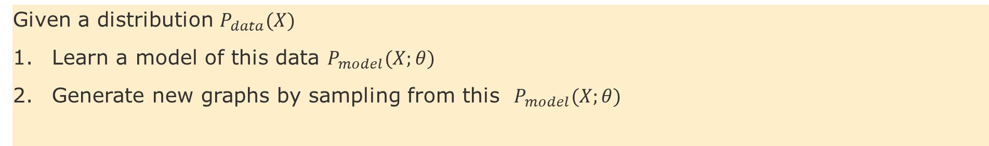
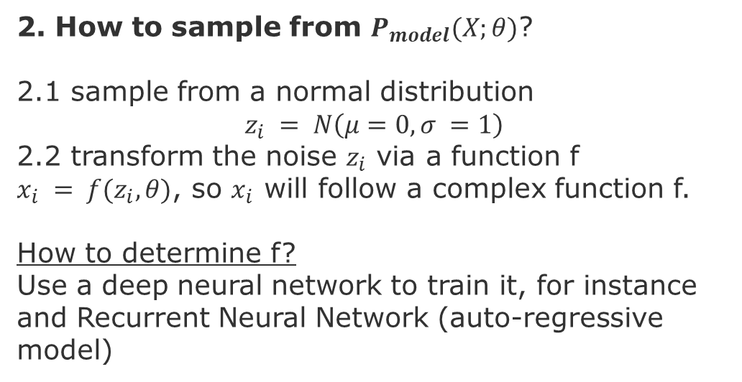
Deep Generative Models
Given a distribution $P_{data}(X)$
Learn a model of this data $P_{model}(X;θ)$
Generate new graphs by sampling from this $P_{model}(X;θ)$
1. How to learn $P_{model}(X;θ)$?
Optimize the parameters $θ$ to approximate the $P_{data}\left(X\right)$
Maximum Likelihood: $θ^{∗} = arg\max_{θ}{E_{x\sim P_{data}}\log{P_{model}}(X|θ)}$,
which means to find parameters $θ^{∗}$so that for the observed datapoints $x_{i}\sim P_{data}(X)$, the $\sum_{i}{\log{P_{model}(x_{i};θ^{∗})}}$ has the highest value, among all possible choices of $θ$
2. How to sample from $P_{model}(X;θ)$?
2.1 sample from a normal distribution
$$z_{i} = N\left(μ=0,σ =1\right)$$
2.2 transform the noise $z_{i}$ via a function f
$x_{i} = f(z_{i},θ)$, so $x_{i}$ will follow a complex function f.
How to determine f?
Use a deep neural network to train it, for instance and Recurrent Neural Network (auto-regressive model)

Slide 20
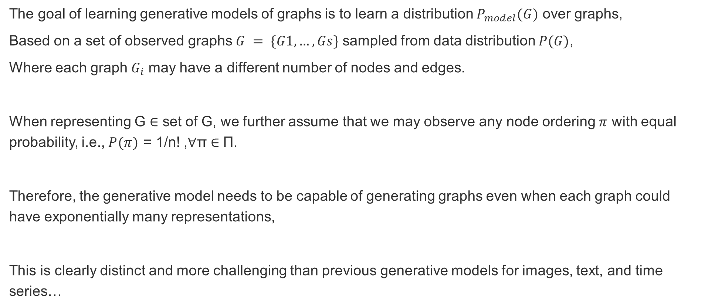
Deep Generative Models - Challenge
The goal of learning generative models of graphs is to learn a distribution $P_{model}(G)$ over graphs,
Based on a set of observed graphs $G = \{G1,…,Gs\}$ sampled from data distribution $P(G)$,
Where each graph $G_{i}$ may have a different number of nodes and edges.
When representing G ∈ set of G, we further assume that we may observe any node ordering $π$ with equal probability, i.e., $P(π)$ = 1/n! ,∀π ∈ Π.
Therefore, the generative model needs to be capable of generating graphs even when each graph could have exponentially many representations,
This is clearly distinct and more challenging than previous generative models for images, text, and time series…

Slide 21
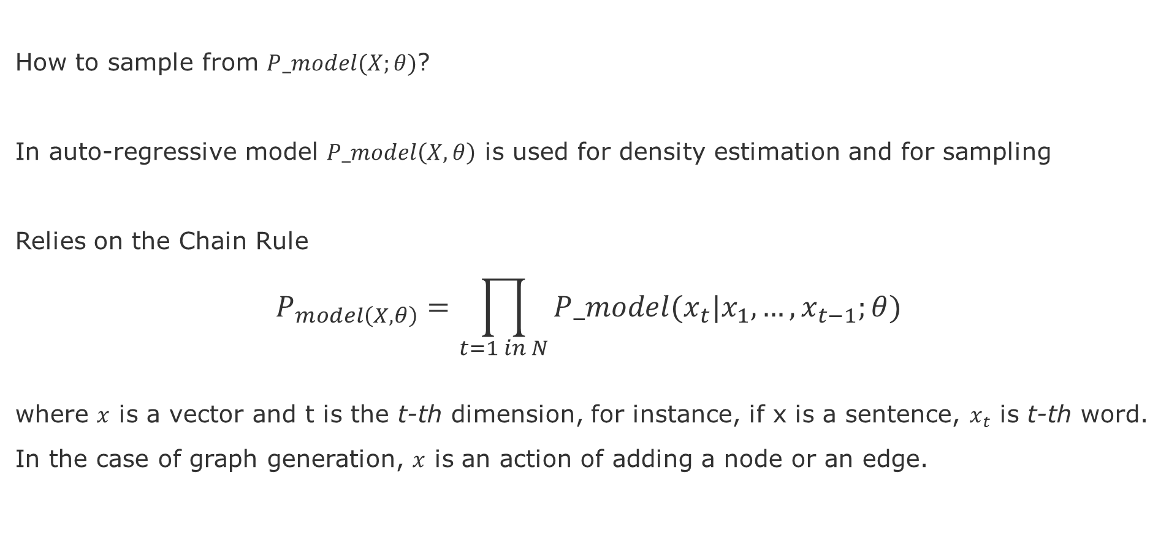
Deep Generative Model
How to sample from $P_model(X;θ)$?
In auto-regressive model $P_model\left(X,θ\right)$ is used for density estimation and for sampling
Relies on the Chain Rule
$$P_{model\left(X,θ\right)}=\prod_{t=1 in N}{P_model(x_{t}|x_{1},…,x_{t−1};θ) }$$
where $x$ is a vector and t is the t-th dimension, for instance, if x is a sentence, $x_{t}$ is t-th word.
In the case of graph generation, $x$ is an action of adding a node or an edge.

Slide 22
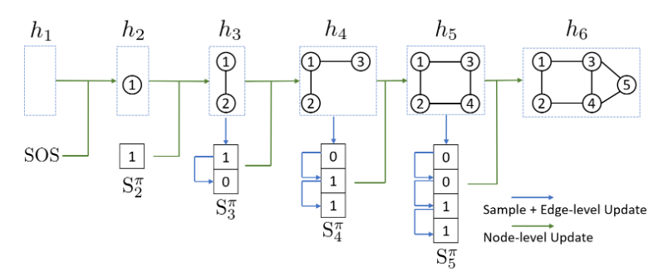


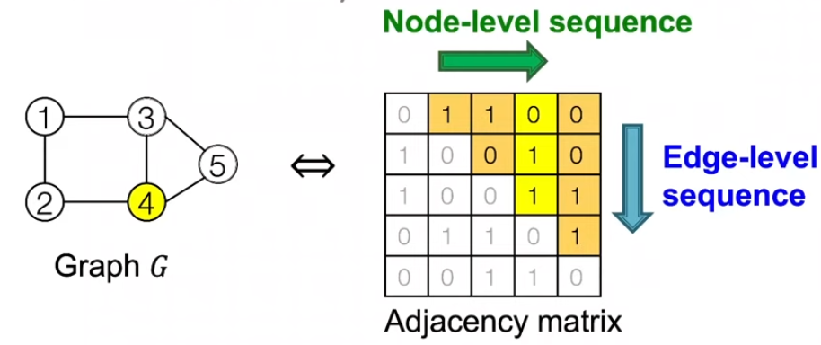
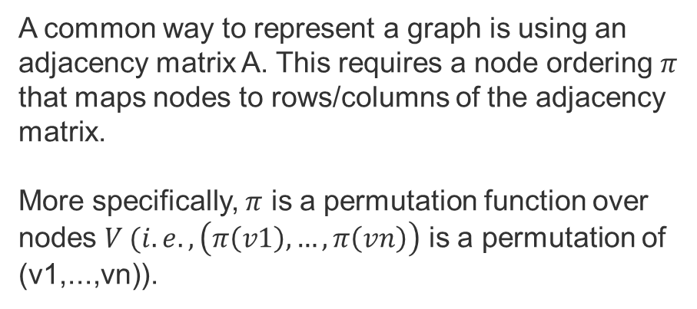
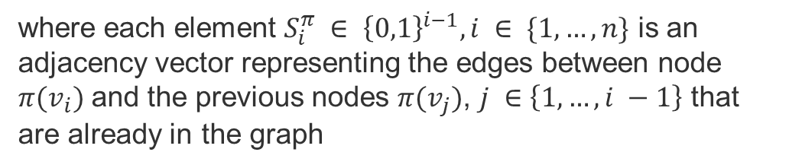
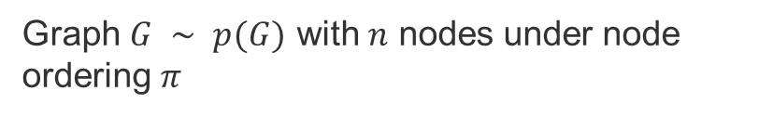
Graph RNN [You et al. 2018]
Graph $G ∼ p(G)$ with $n$ nodes under node ordering $π$
Graph Sequence definition:
where each element $S_{i}^{π} ∈ {\left\{0,1\right\}}^{i−1},i ∈ \{1,…,n\}$ is an adjacency vector representing the edges between node $π(v_{i})$ and the previous nodes $π(v_{j})$, $j ∈\left\{1,…,i −1\right\}$ that are already in the graph
A common way to represent a graph is using an adjacency matrix A. This requires a node ordering $π$ that maps nodes to rows/columns of the adjacency matrix.
More specifically, $π$ is a permutation function over nodes $V (i.e., \left(π\left(v1\right),…,π\left(vn\right)\right)$ is a permutation of (v1,...,vn)).
Adjacency matrices
Sources:
You, J., et al., 2018, GraphRNN: Generating Realistic Graphs with Deep Auto-regressive Models, in proc. of the 35th International Conference on Machine Learning
Jures Leskovec, slides CS224W: Machine Learning with Graphs | 2021 | Lecture 15.2

Slide 23
Task– Tuesday Nov. 8
Read evaluation of the following paper:
Rossi, Emanuele, et al. "Temporal graph networks for deep learning on dynamic graphs." arXiv:2006.10637 (2020). https://blog.twitter.com/engineering/en_us/topics/insights/2021/temporal-graph-networks
Find one second paper with similar evaluations of Spatio-Temporal Graphs
Draft the section of the report with definitions for the types of evaluations and threats to validity

Slide 24
END

